Slide 1
Inter-temporal Choice-III
Time Preference

Slide 2
Time preference
The primary reason for the variability is the existence of confounding factors in the measurement of time preference.
Confounding factors involved in the measurement of time preference:
Consumption reallocation
Intertemporal arbitrage
Concave utility
Uncertainty
Inflation
Expectations of changes in utility
Anticipatory utility
Visceral influences

Slide 3
Confounding Factors
Consumption reallocation
Most studies use monetary rewards as payoffs rather than consumption. When discount rates are calculated it is normally assumed that rewards and losses are consumed immediately.
Example: reward of INR 10000
Intertemporal arbitrage
When rewards are tradable, like money, intertemporal choices may not reflect time preference directly, but may be caused by intertemporal arbitrage.
Example: If a person prefers $100 now to $150 in five years time, this may be because they can invest$100 now at the market rate of interest and make it worth more than $150 in five years.

Slide 4
Continued....
Concave utility
The concavity of the utility function implies that the person is risk averse: a sure amount would always be preferred over a risky bet having the same expected value.
Say that the average response of a group of subjects is that they are indifferent between $100 now and $150 in five years. The imputed discount rate is 8.1% a year on the basis of the monetary amounts. However it may be that the $150 has only 30% more utility than $100. Using utility as the basis for discounting, the imputed discount rate is only 5.2%. This shows that utility discount rates are lower than monetary discount rates when utility functions are concave.

Slide 5
Continued....
Uncertainty
Future rewards and costs are almost invariably associated with uncertainty in practice. For example, even if we can be sure that a particular electrical appliance will save us a certain amount of electricity in the future, we cannot be sure what will be the future price of electricity.
In experimental studies it might appear that investigators could avoid this confound by assuring subjects that delayed rewards will be delivered with certainty.

Slide 6
Continued....
Inflation
Most studies ignore the effect of inflation in the calculation of discount rates. In practice people are likely to discount future monetary rewards according to their experiences with and expectations of inflation.
The effect of future inflation on purchasing power becomes more uncertain as the duration of delay increases.
Expectations of changes in utility
if we expect to have higher consumption levels in the future, the marginal utility of $100 of consumption now is greater than the marginal utility of $100 of consumption in fi ve years, because of the effect of the law of diminishing marginal utility. This effect exerts an upward bias on discount rates.

Slide 7
Continued....
Defer consumption to later periods in order to have a rising consumption over time- lack of self-control to save sufficient income earned now to provide for this future consumption- commitment device-downward bias on discount rates.
Anticipatory utility
The effect is to exert a downward bias on discount rates and can also cause reverse time-inconsistency of preferences.
Visceral influences
The prospect of an immediate reward may stimulate visceral factors that temporarily increase the attraction of the reward.

Slide 8
What is time preference?
Psychological constructs or traits must satisfy the following three criteria:
Constancy: Constructs tend only to be useful when they remain constant within the same person over time.
Generality: Constructs or traits should be able to predict a wide range of behaviors
Correlation between different measures

Slide 9
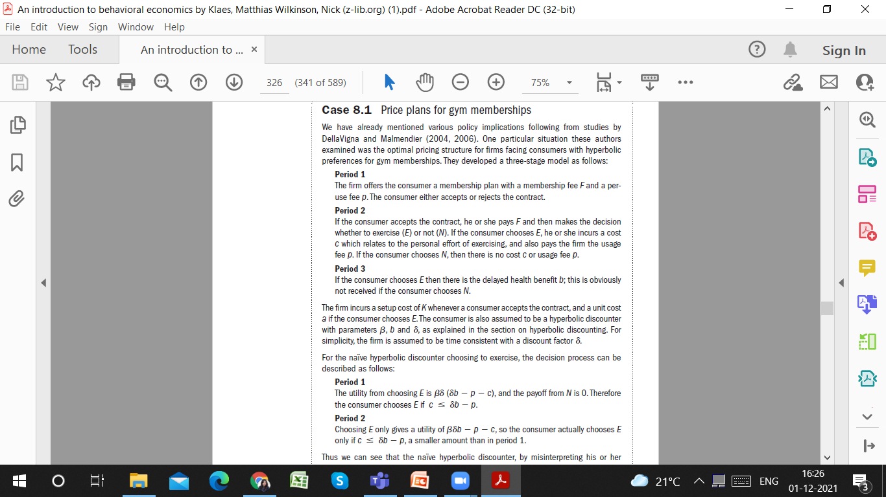
Case 1: Price plans for gym memberships

Slide 10
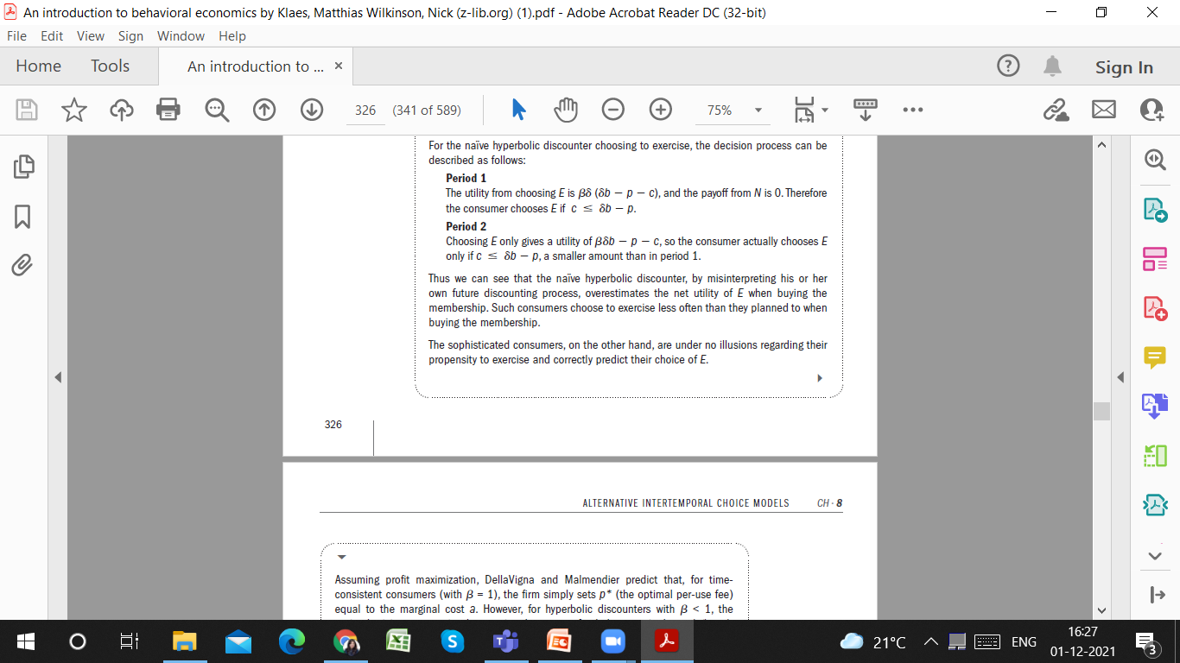

Slide 11
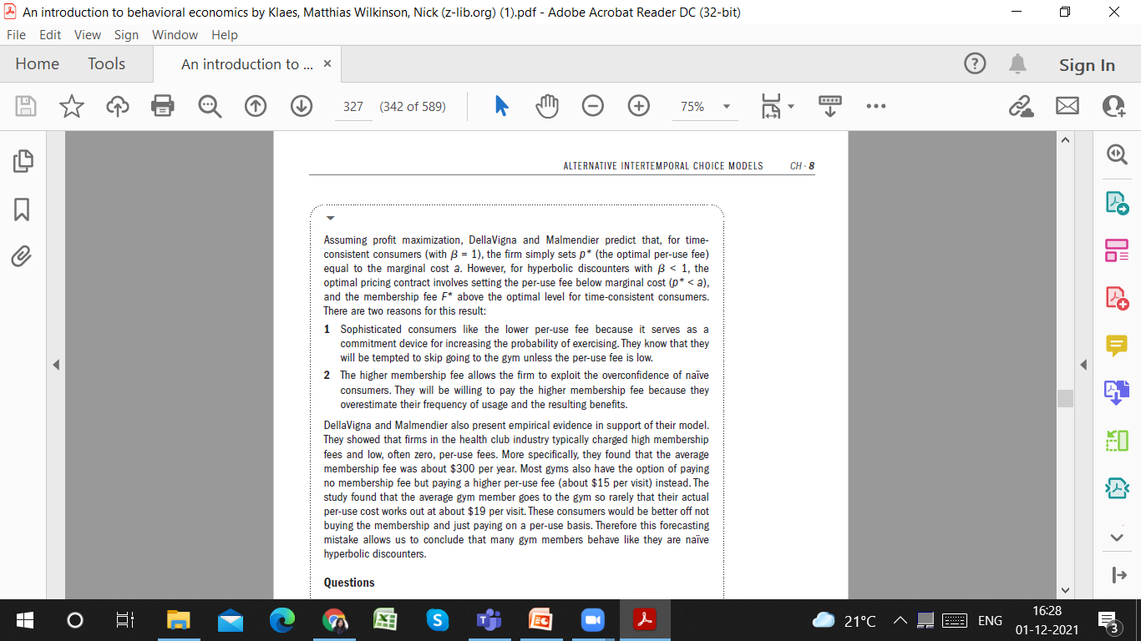

Slide 12
